Slide 1
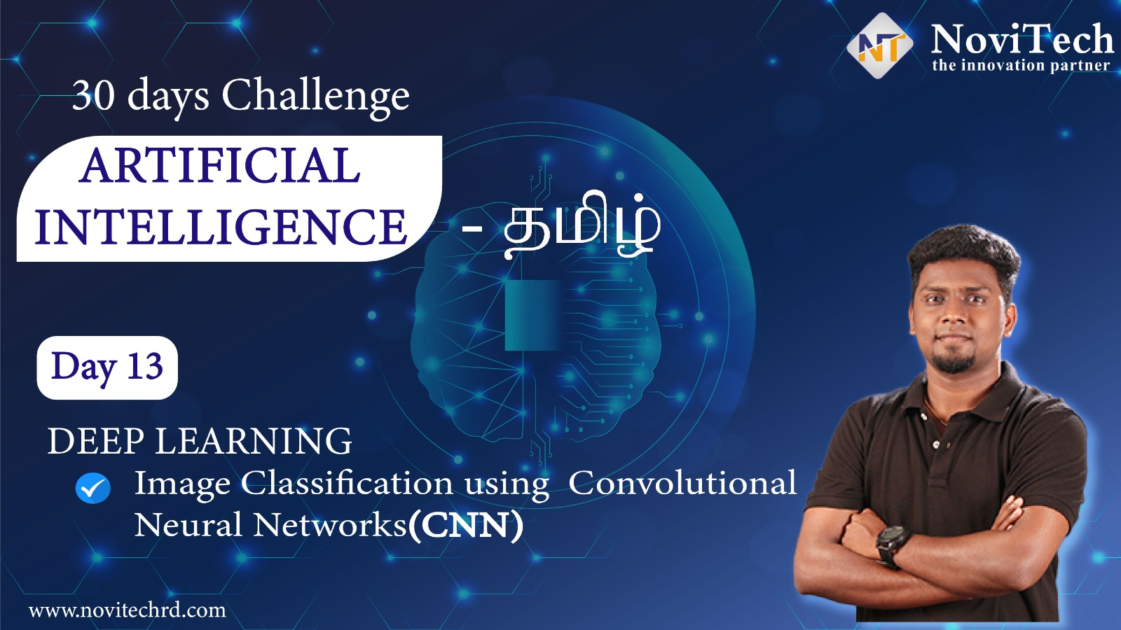

Slide 2
Prerequisites for this Course
Laptop with Good Internet
No basic knowledge is required.
Note & Pen

Slide 3
Image Classification
Image classification is a supervised learning problem: define a set of target classes (objects to identify in images), and train a model to recognize them using labeled example photos.

Slide 4
Block Diagram – Workflow of Image Classification CNN
Dataset Creation
Train, Test, Val
CNN Design
Pre-Processing
Training - Model
Load Model - Test
Pre-process Input Image
Classification

Slide 5
CNN
0
Convolutional Layer
1
Flattening
Pooling
Input
Output

Slide 6
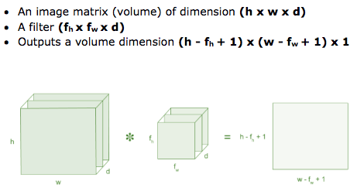
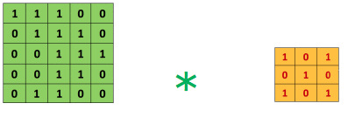
Convolution - Process

Slide 7
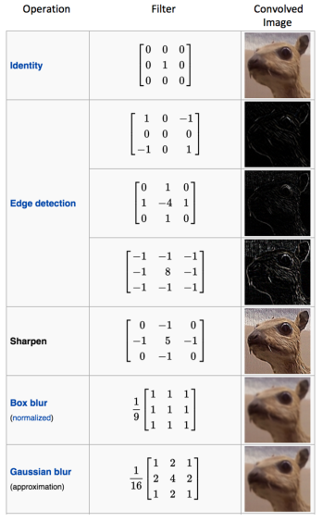
Convolution - Filter

Slide 8
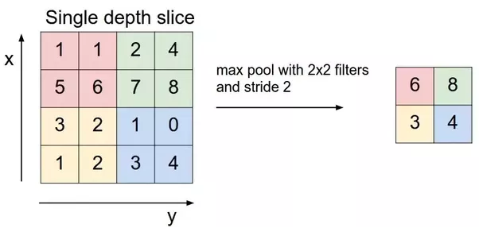
Pooling – Max Pooling

Slide 9
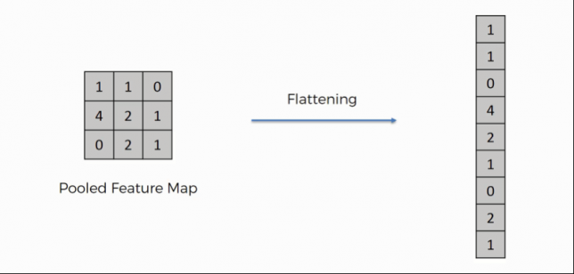
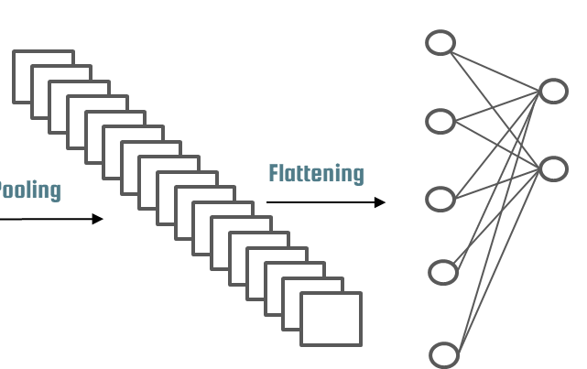
Flattening

Slide 10
Fully Connected
Dense
model.add(Dense(units = 128, activation = 'relu'))
Dense - Fully connected layer,
Units - Number of nodes present in a hidden layer
Activation function: rectifier function.
Output Layer
classifier.add(Dense(units = 1, activation = 'sigmoid'))
Units = 1 - Binary classification
Activation function - Sigmoid, gives binary output ‘0’ or ‘1’.

Slide 11
Model Train - Fit
model.fit_generator(training_set,
steps_per_epoch = 10,
epochs = 25,
validation_data = val_set,
validation_steps = 2)
Steps_per_epoch – No. of Image in Training Dataset / Batch Size
Epoch – Iteration
Validation_steps – No. of Image in Validation Dataset / Batch Size

Slide 12
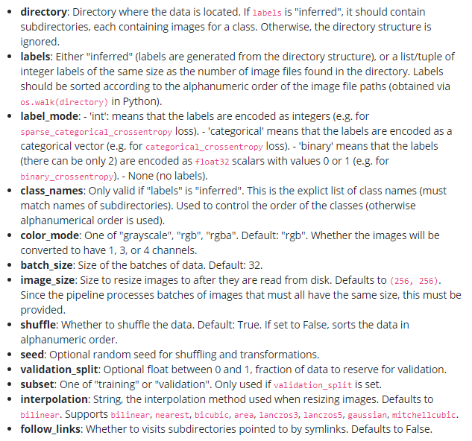
Compiling
Pre-Processing – Image Datagenerator
classifier.compile(optimizer = 'adam', loss = 'binary_crossentropy', metrics = ['accuracy'])
image_dataset_from_directory(
directory,
labels="inferred",
label_mode="int",
class_names=None,
color_mode="rgb",
batch_size=32,
image_size=(256, 256),
shuffle=True,
seed=None,
validation_split=None,
subset=None,
interpolation="bilinear",
follow_links=False,
)

Slide 13
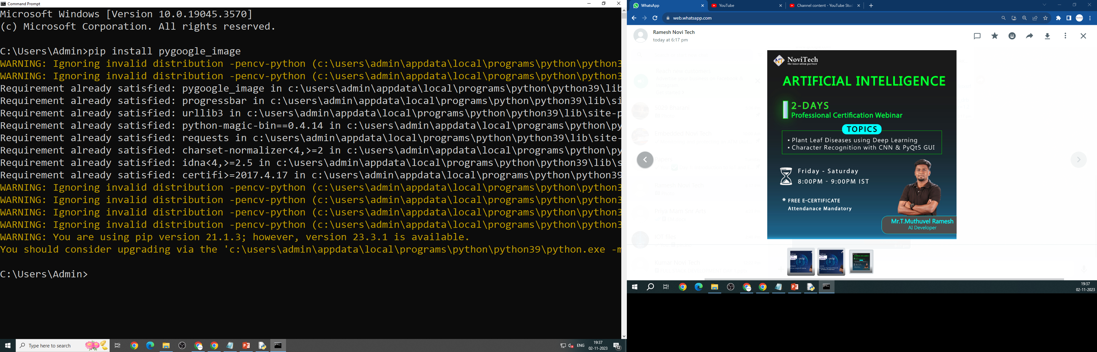
!Bonus!
OpenCV-Contrib : pip install pygoogle_image

Slide 14
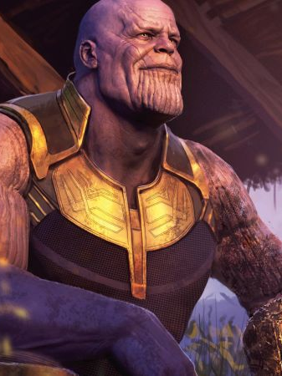
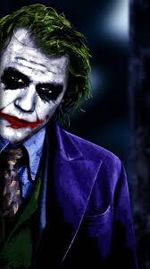
Ready For Hands On
Image Classification of Thanos & Joker

Slide 15




THANK YOU☺
NOVITECH COIMBATORE
novitechresearchanddevelopment

